Slide 1
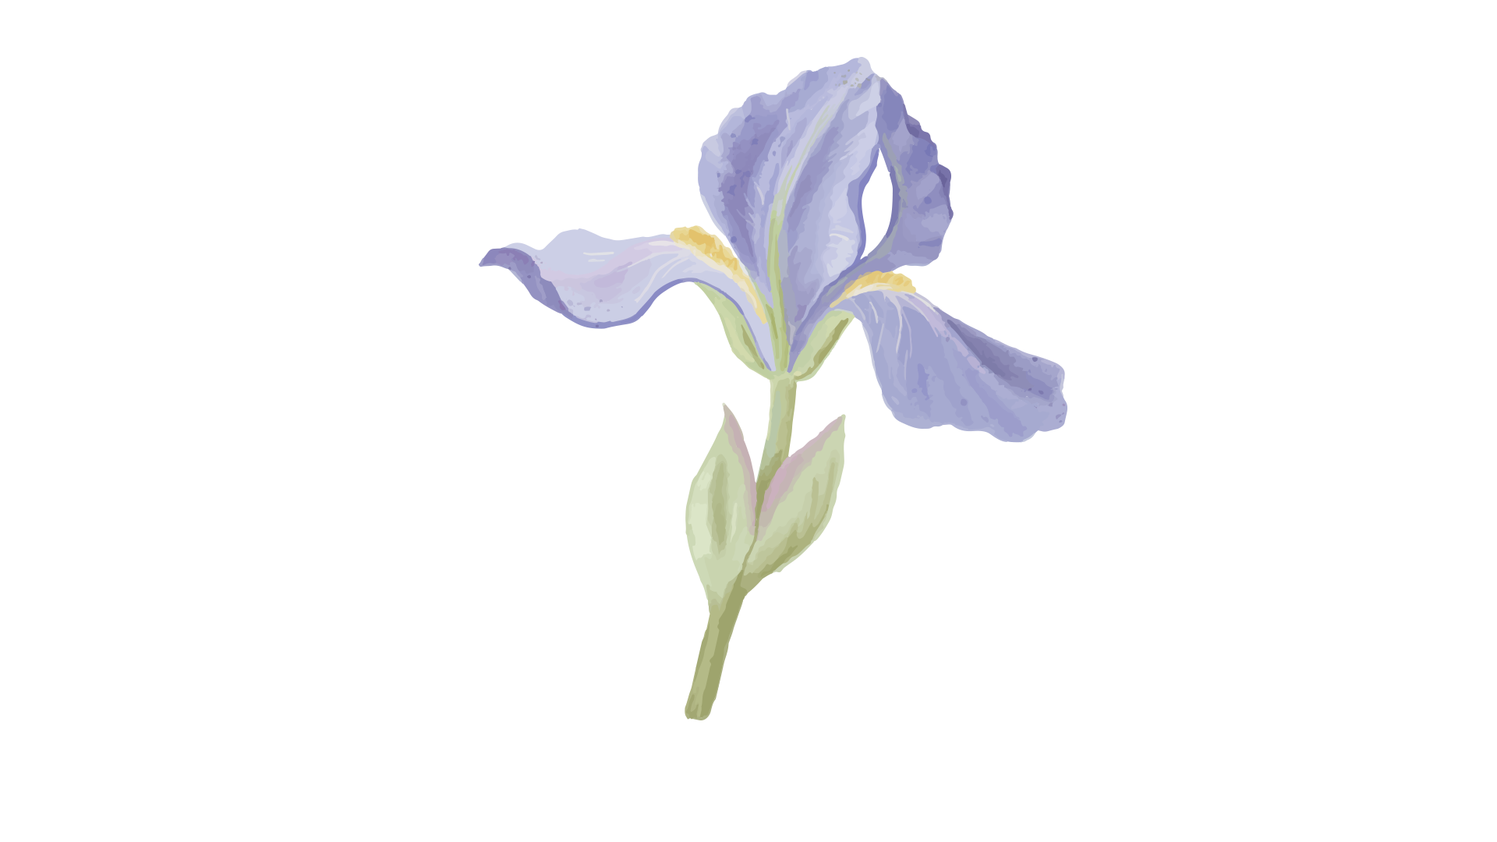
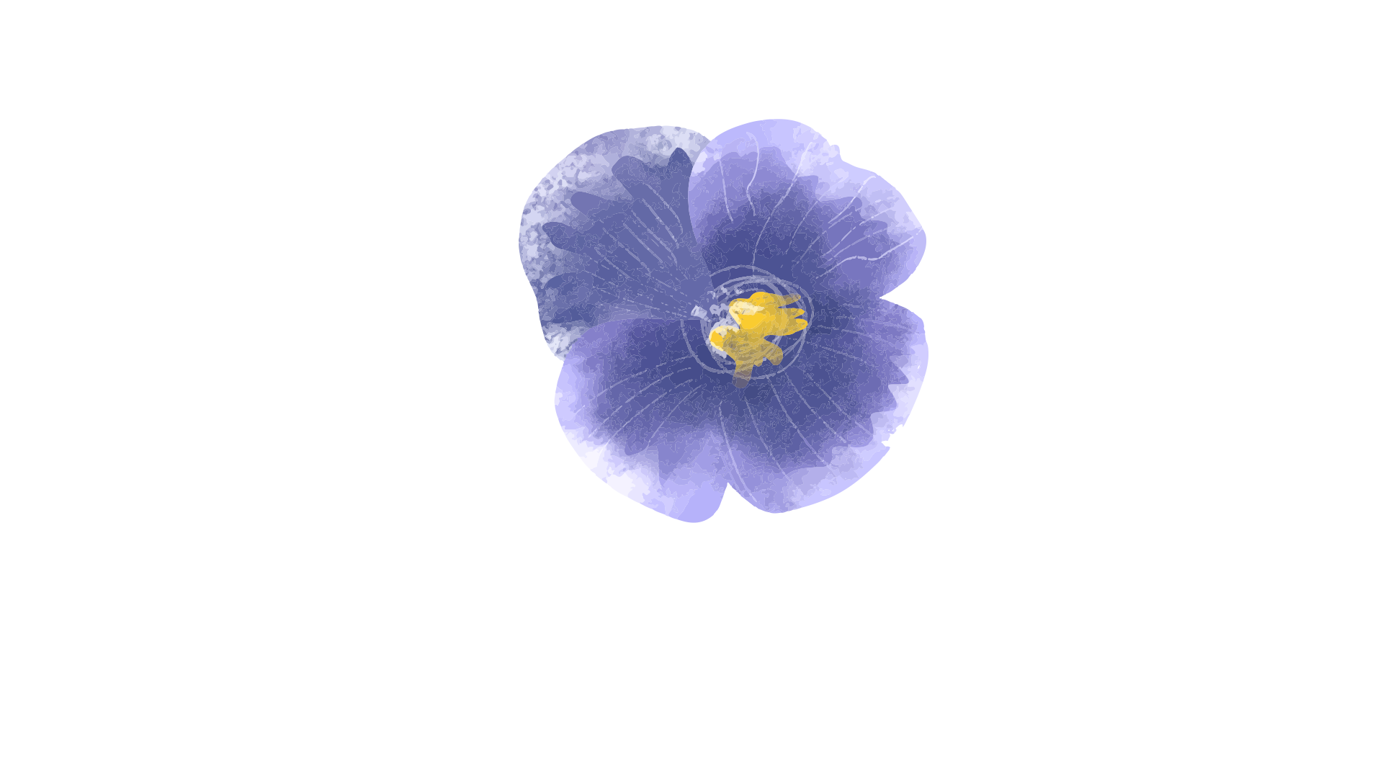

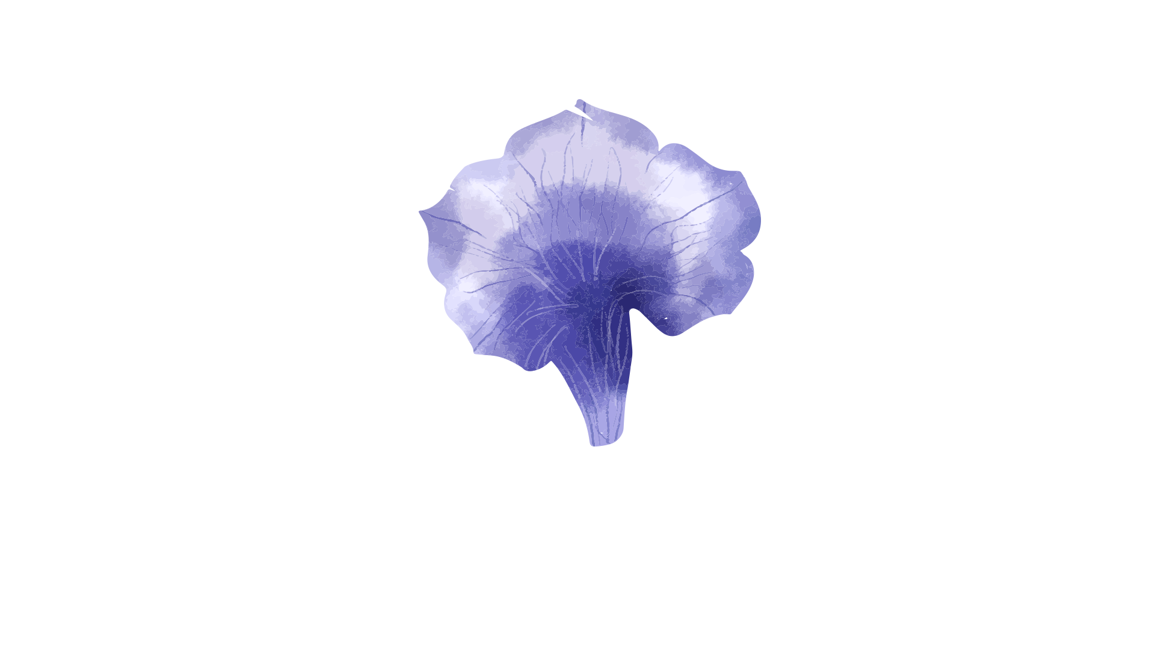
Iris Classification
By- Kumari Neha

Slide 2
Introduction
The Iris Classification project is a machine learning task that focuses on classifying iris flowers into three species: Setosa, Versicolour, and Virginica.
This is done using the flower's sepal length, sepal width, petal length, and petal width. This project is often used as an introduction to classification algorithms, making it ideal for learning the basics of machine learning.

Slide 3
Objective
The goal of this project is:
To accurately classify iris flowers into their respective species.
To ensure consistent and reliable predictions using cross-validation.
To document the entire process, including code, visualizations, and results.

Slide 4
Steps
Understand the problem: Classify flowers by species.
Prepare data: Use the Iris dataset and extract features.
Explore data: Analyze patterns with visualizations.
Preprocess: Handle missing values and split data.
Train models: Test algorithms like KNN and SVM.
Evaluate: Measure accuracy and performance.
Tune: Optimize with Grid Search or cross-validation.
Interpret: Highlight key features and insights.

Slide 5
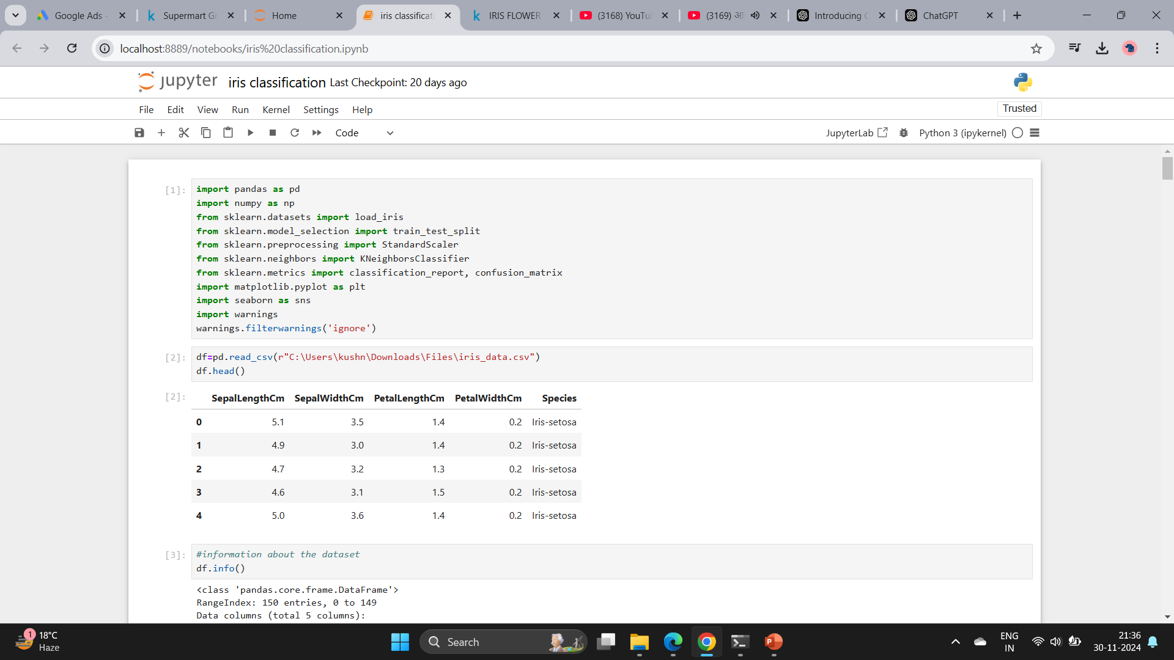

Slide 6
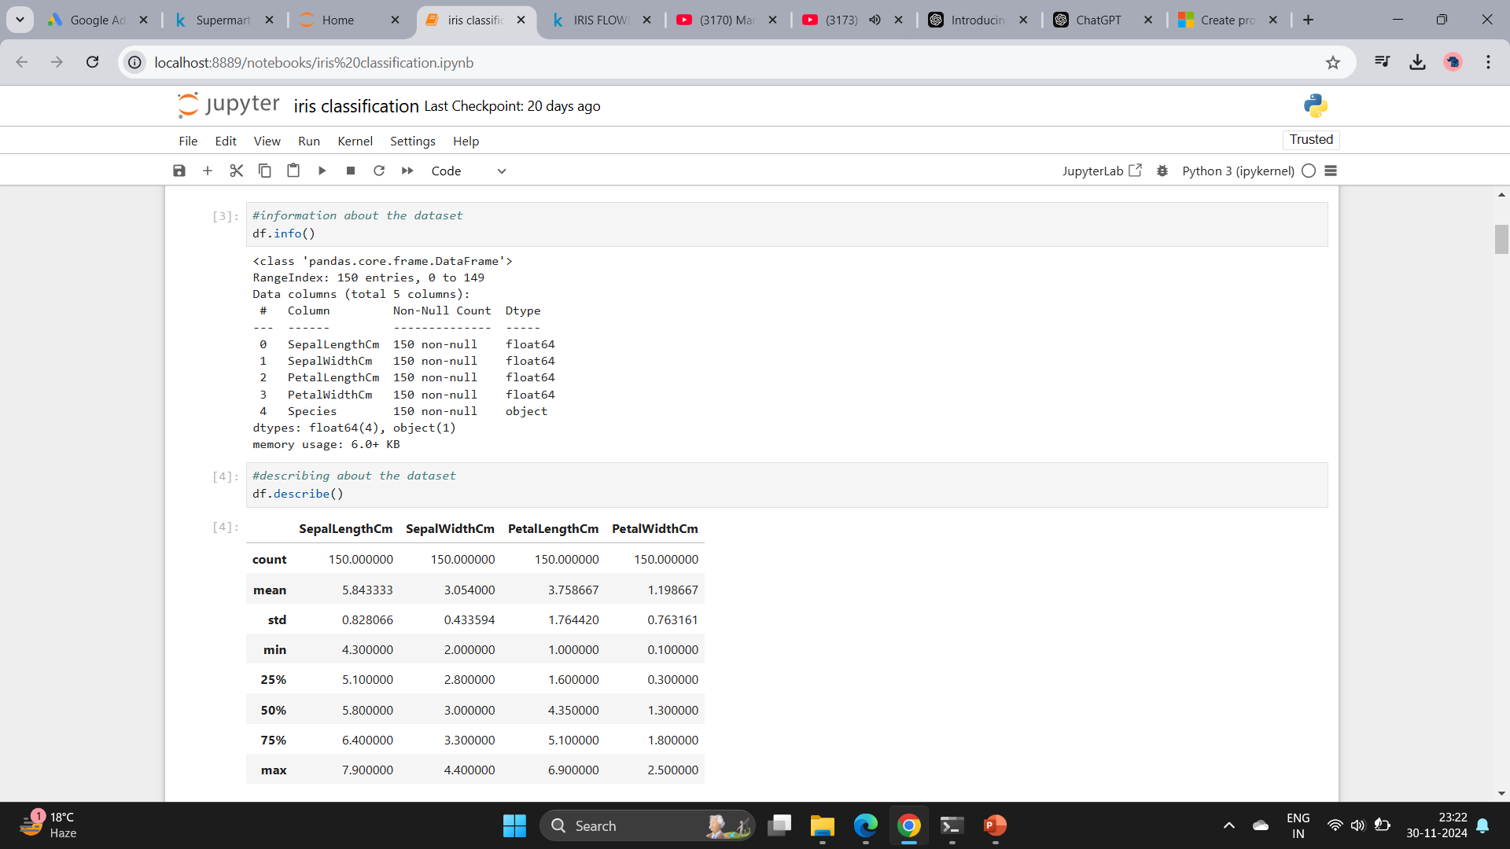

Slide 7
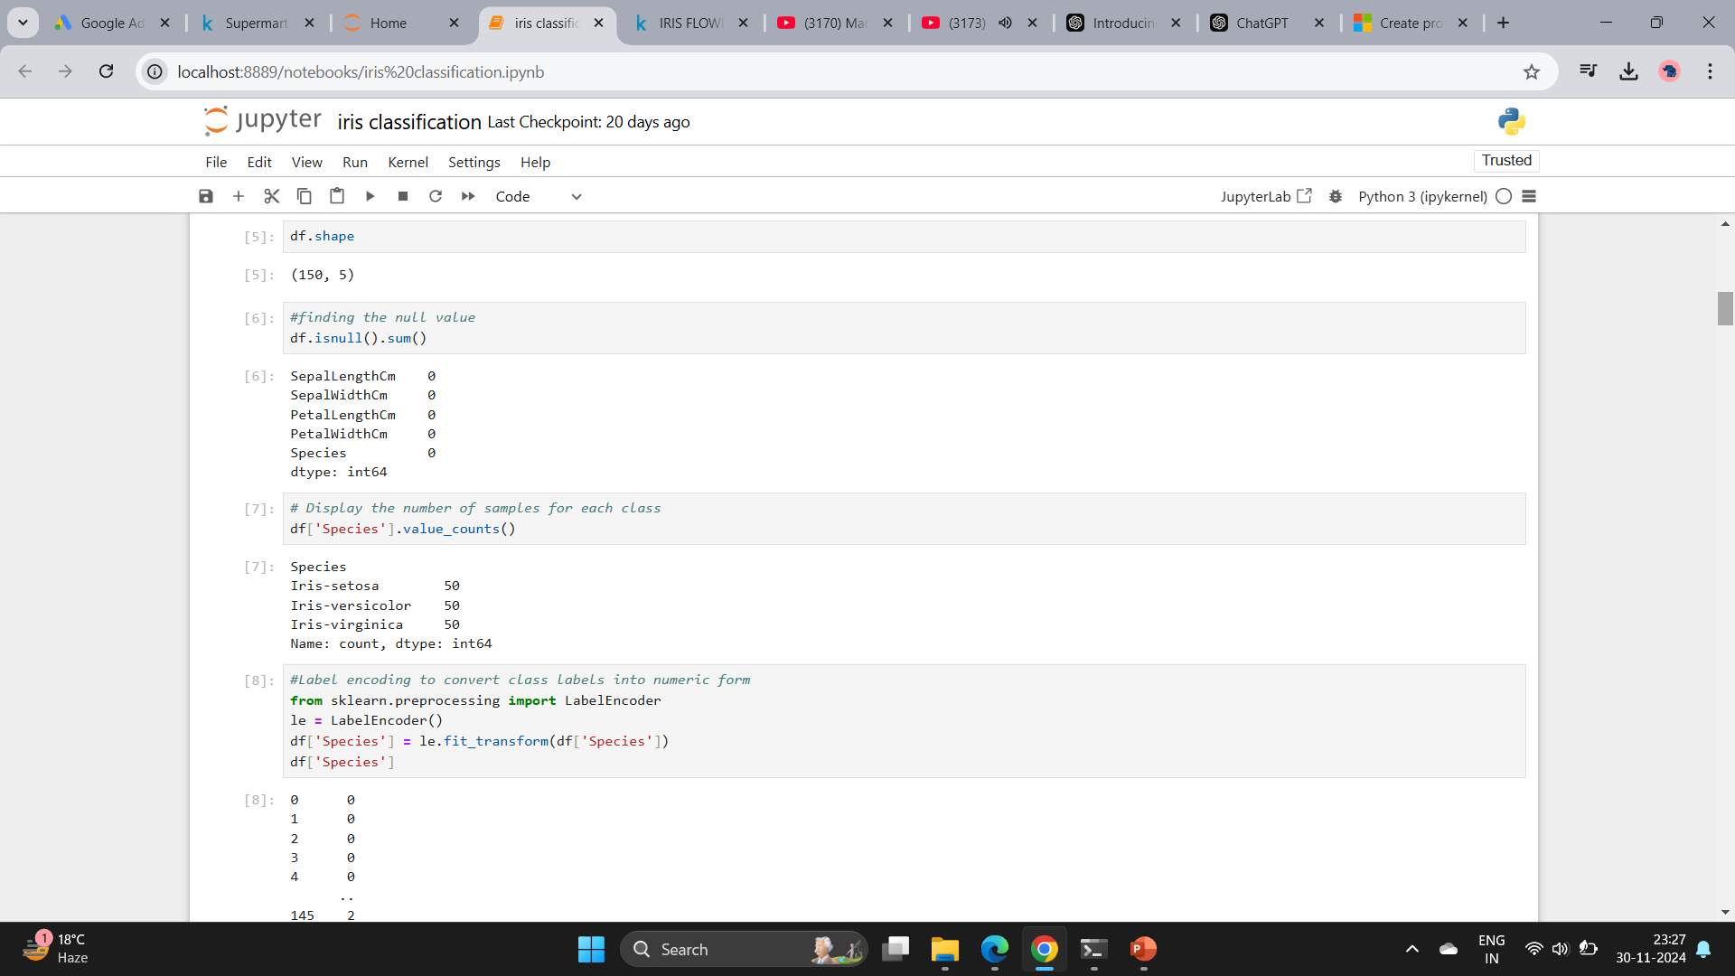

Slide 8
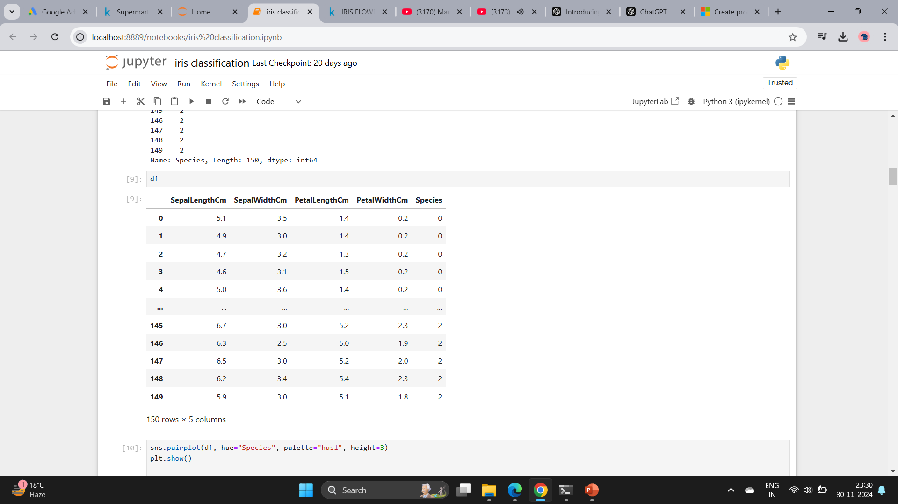

Slide 9
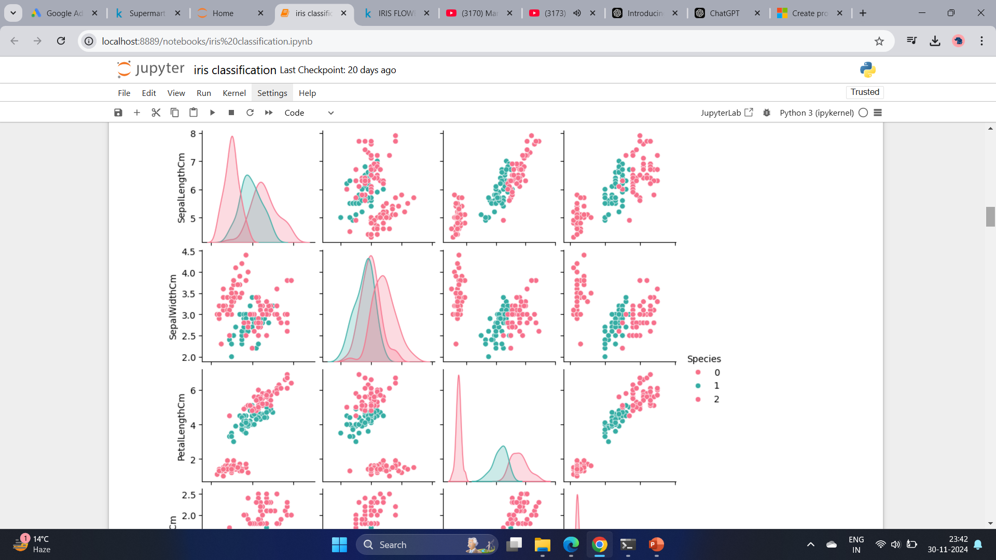
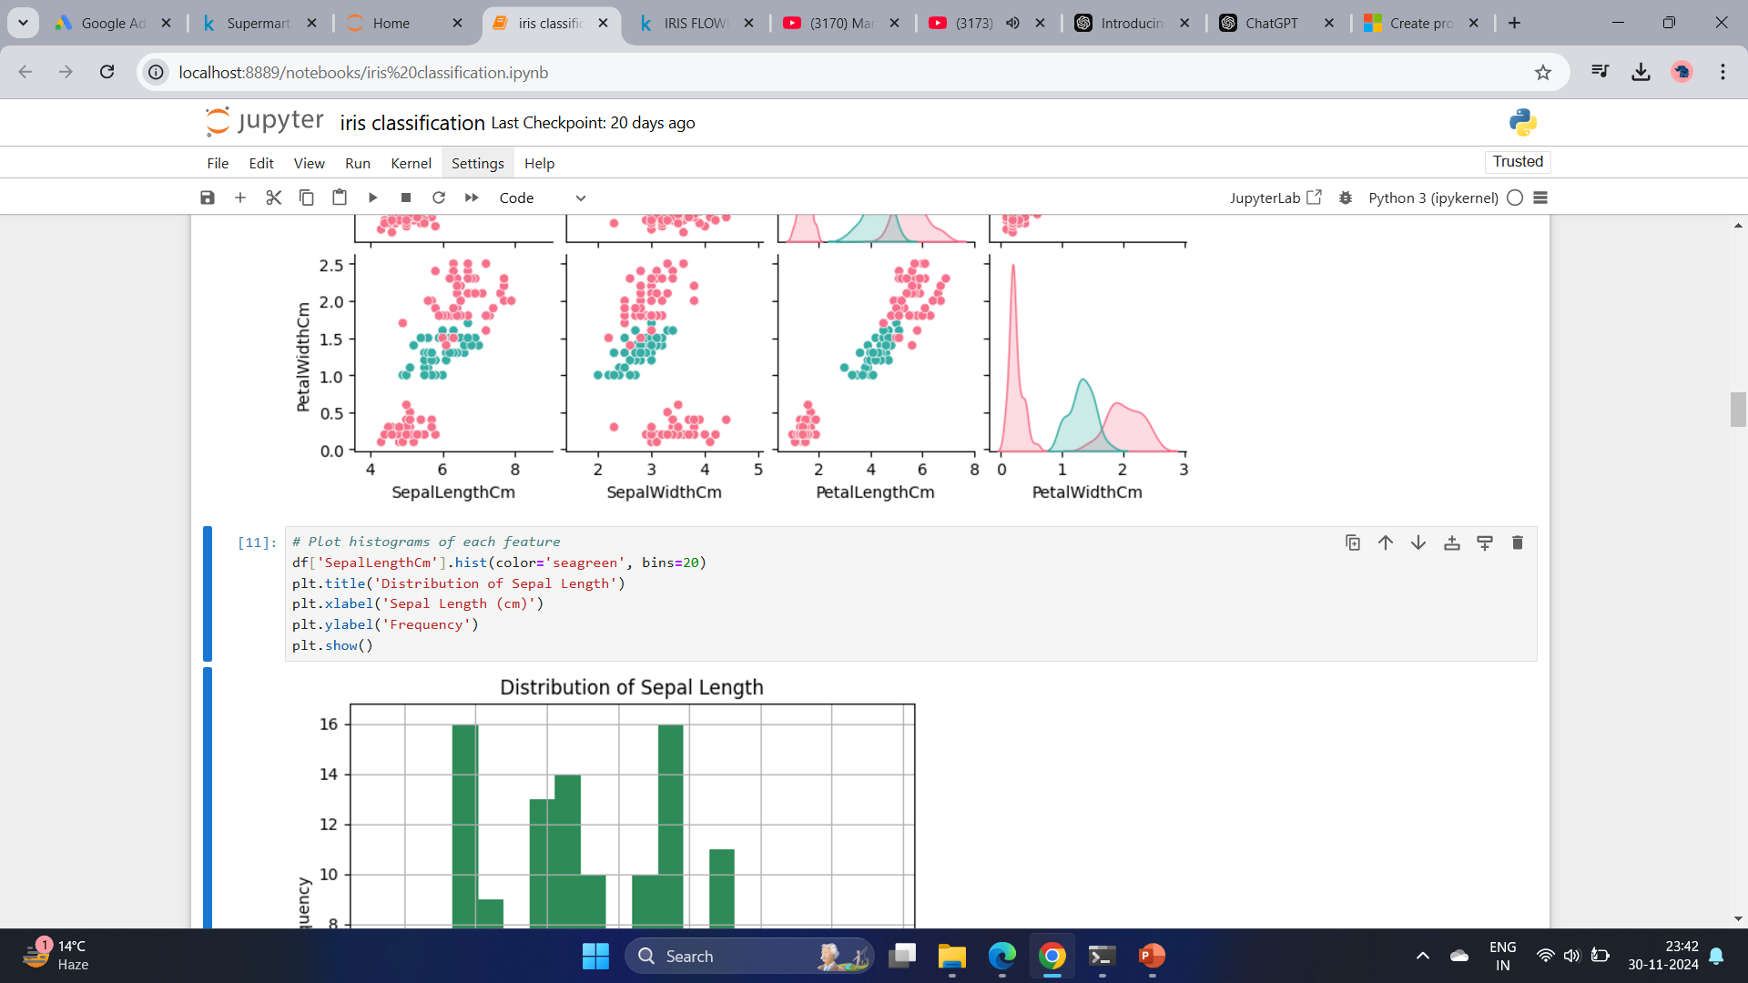

Slide 10
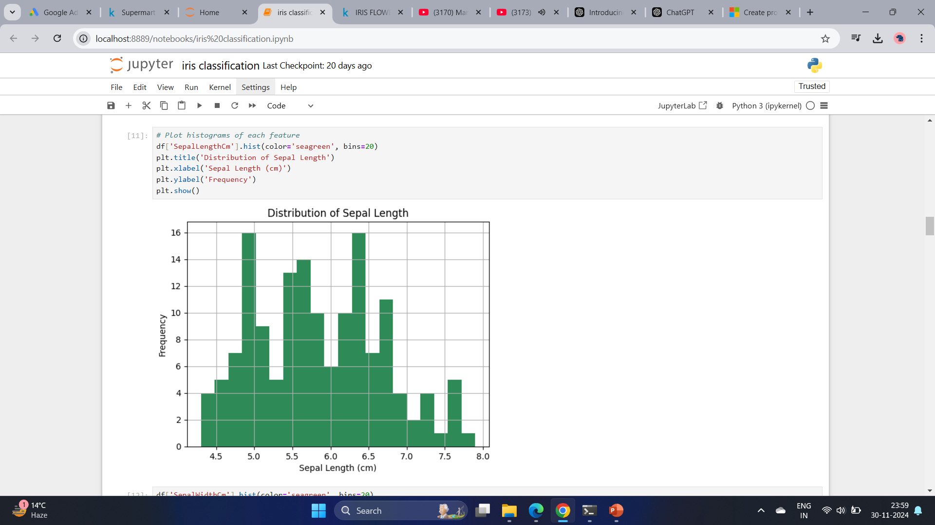

Slide 11
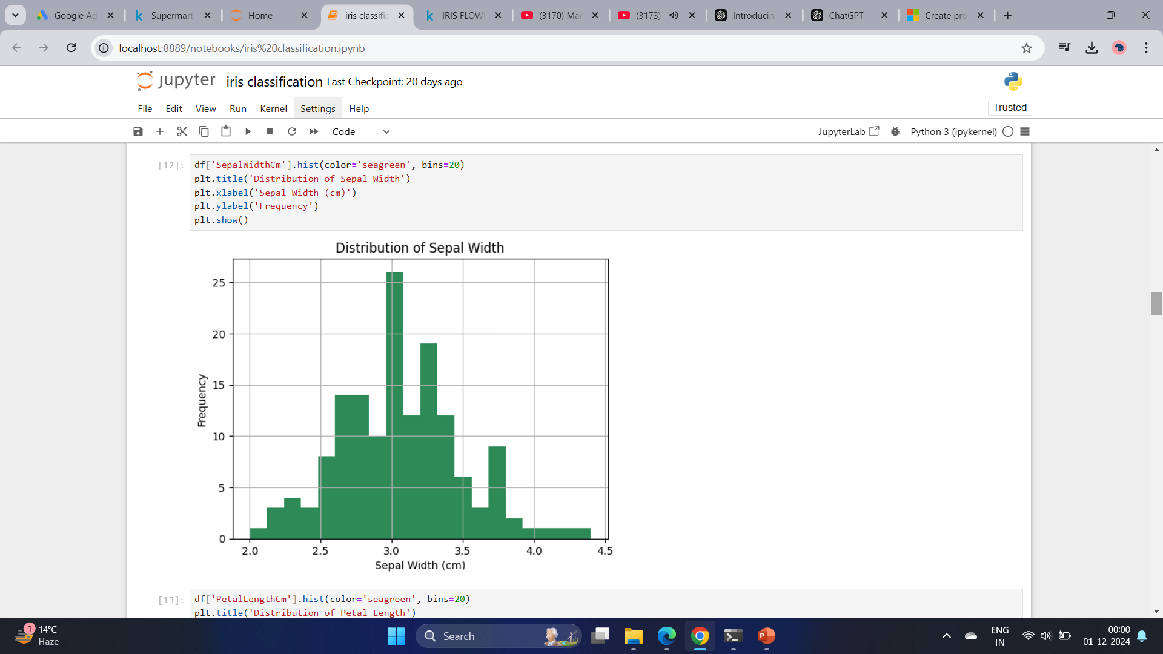

Slide 12
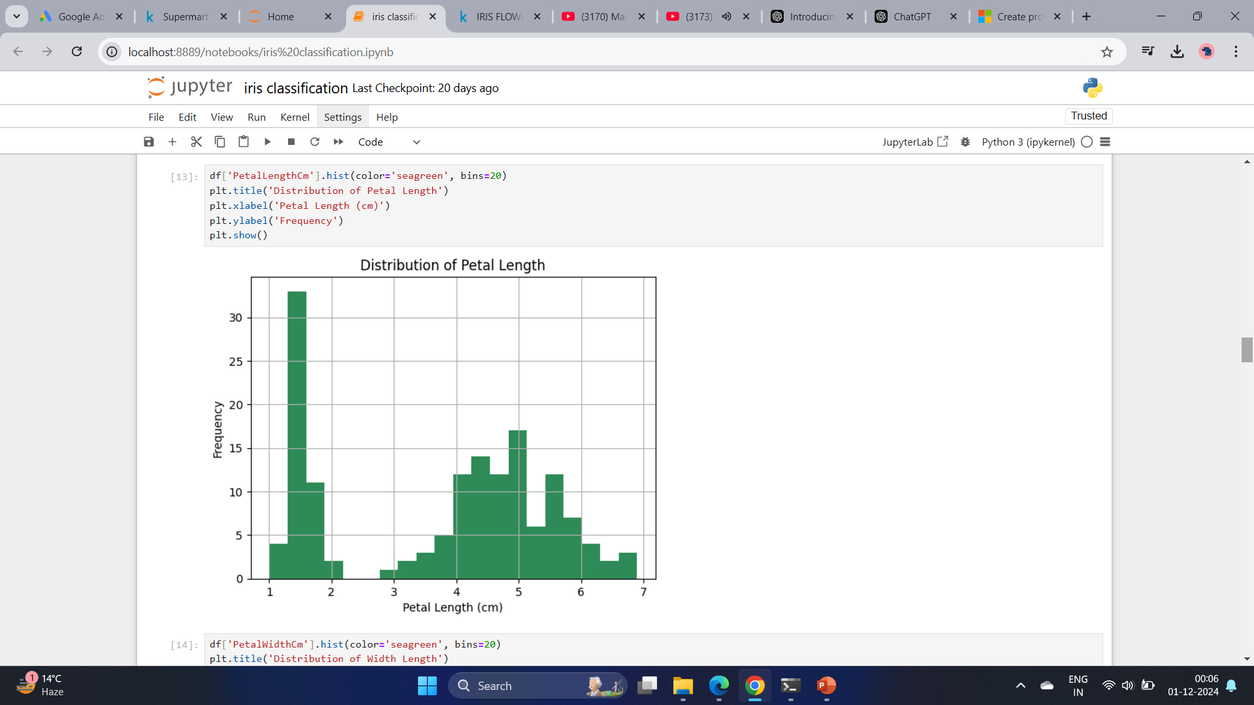

Slide 13
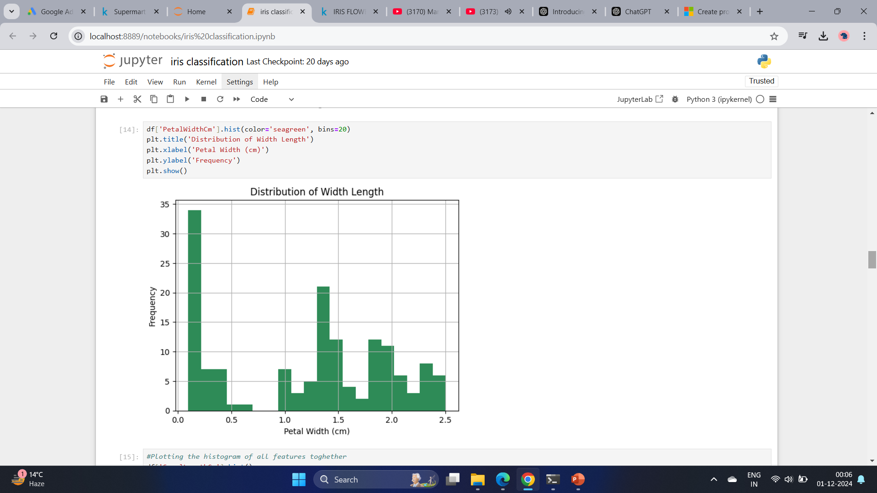

Slide 14
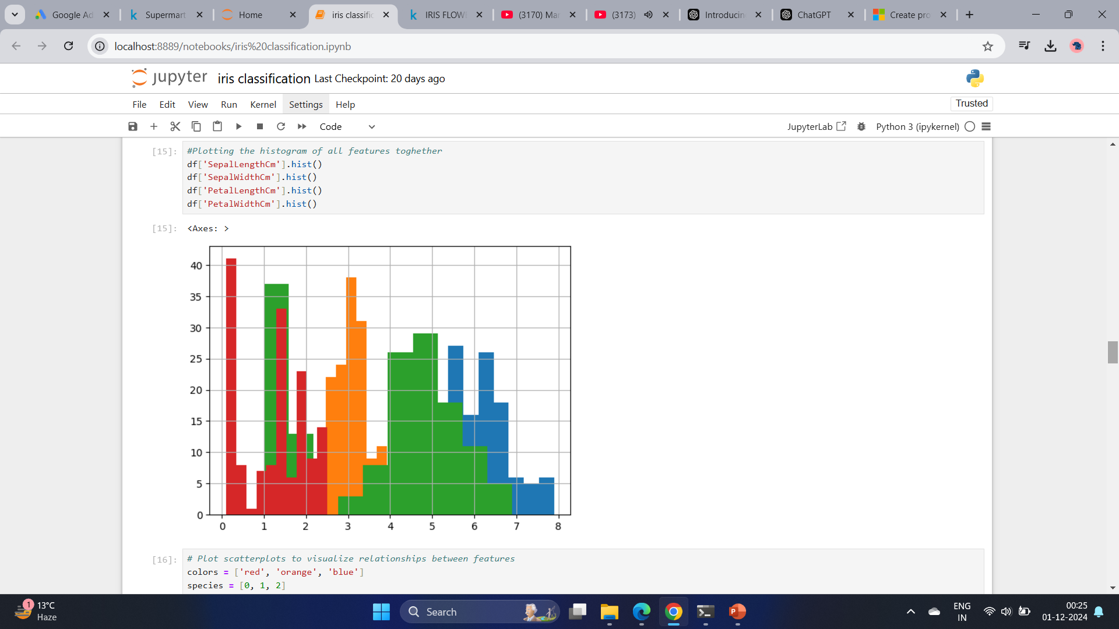

Slide 15
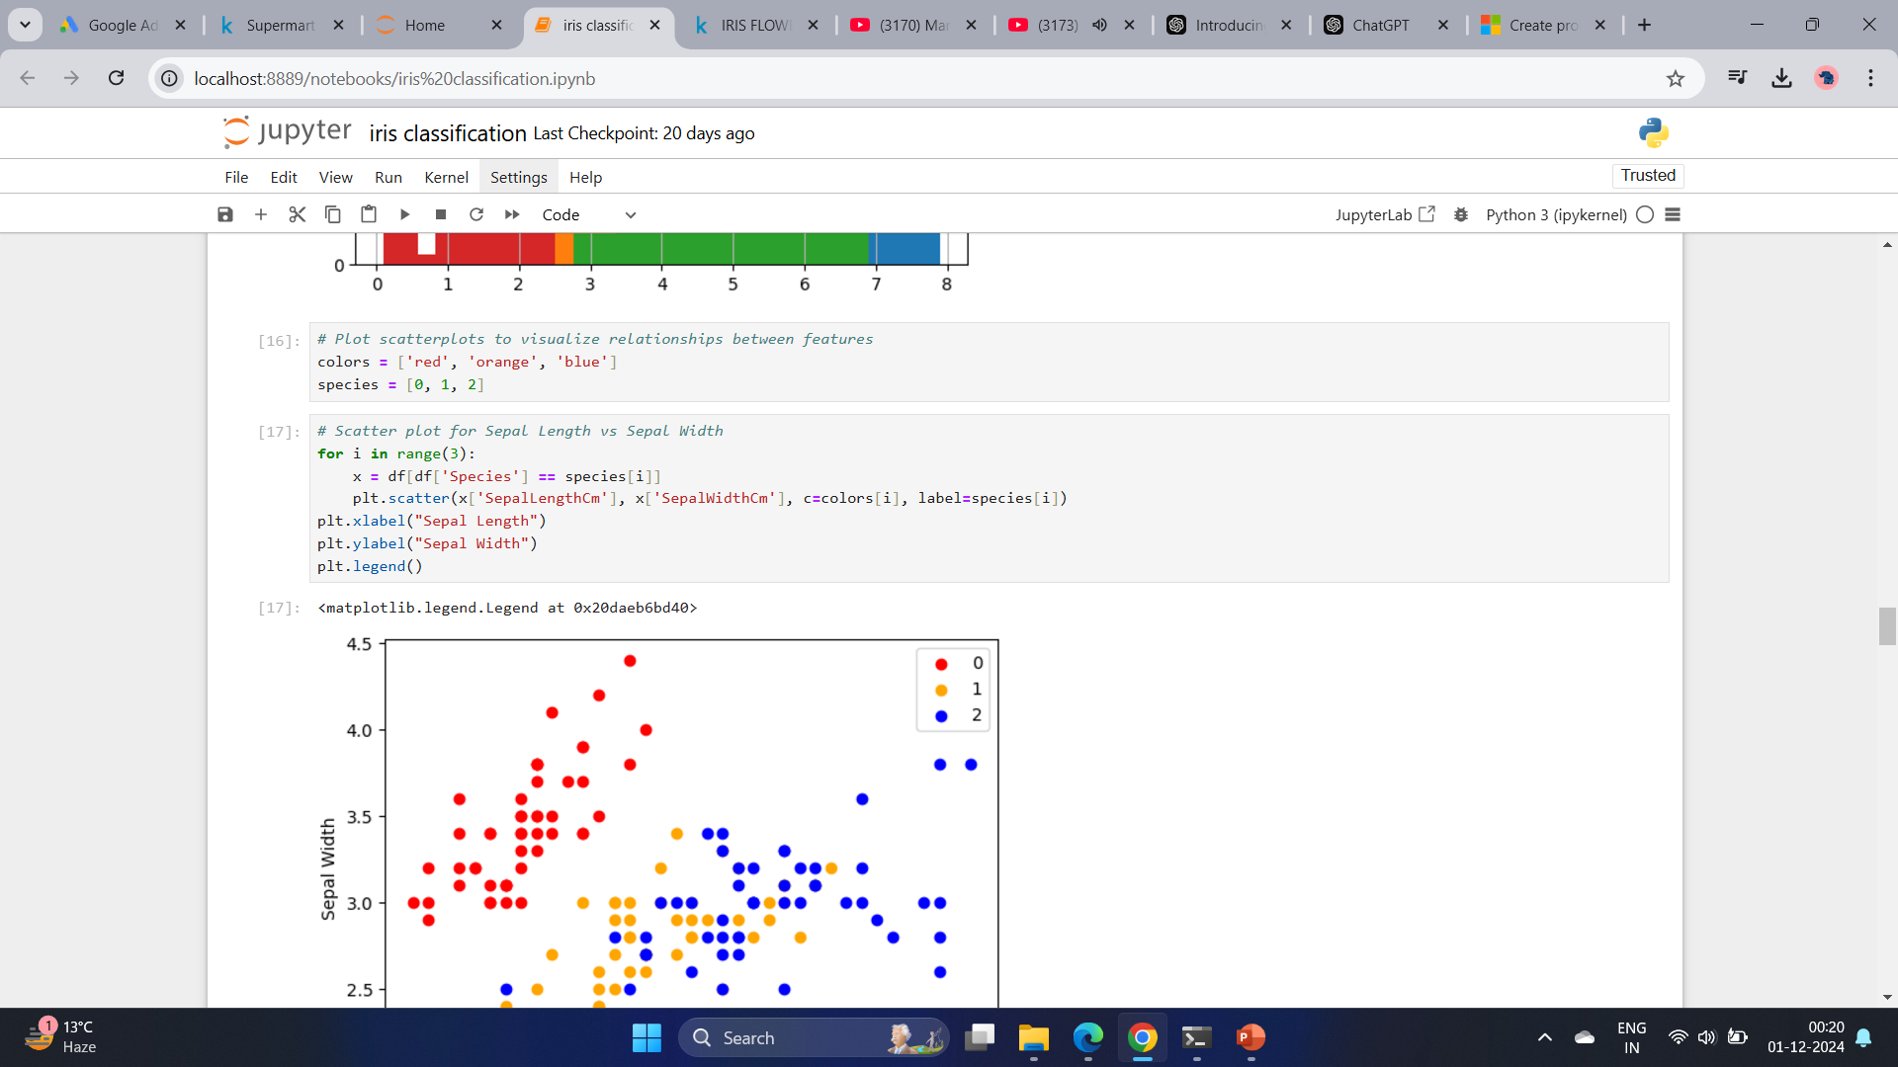

Slide 16
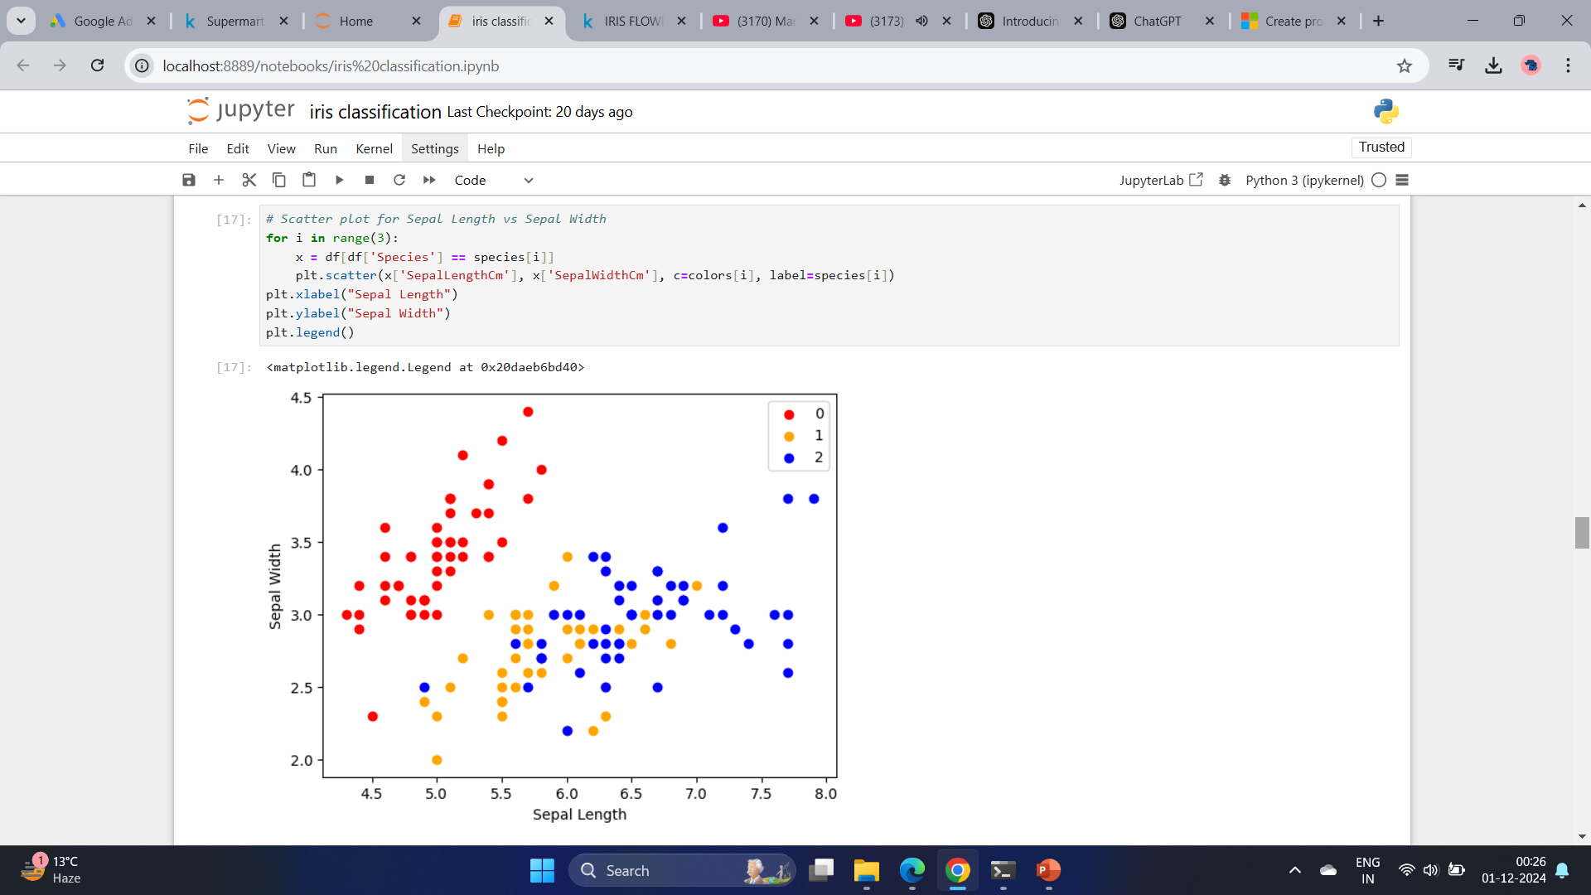
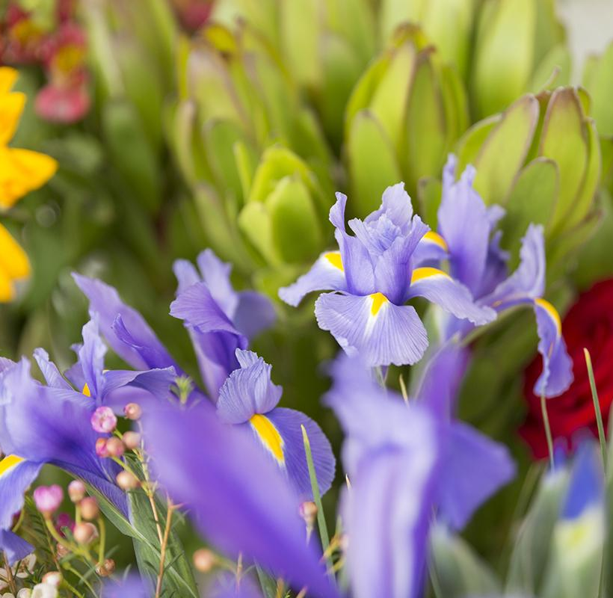

Slide 17
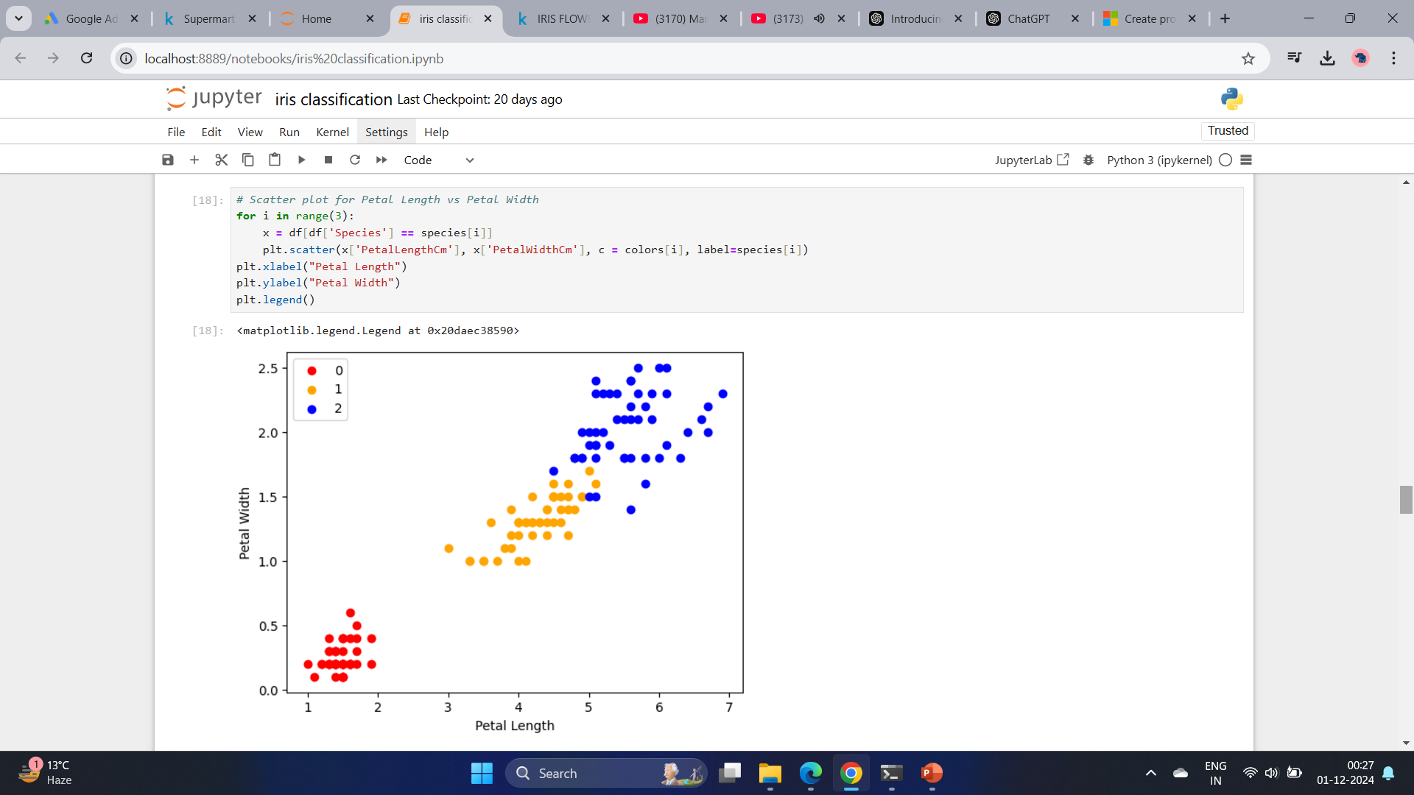

Slide 18
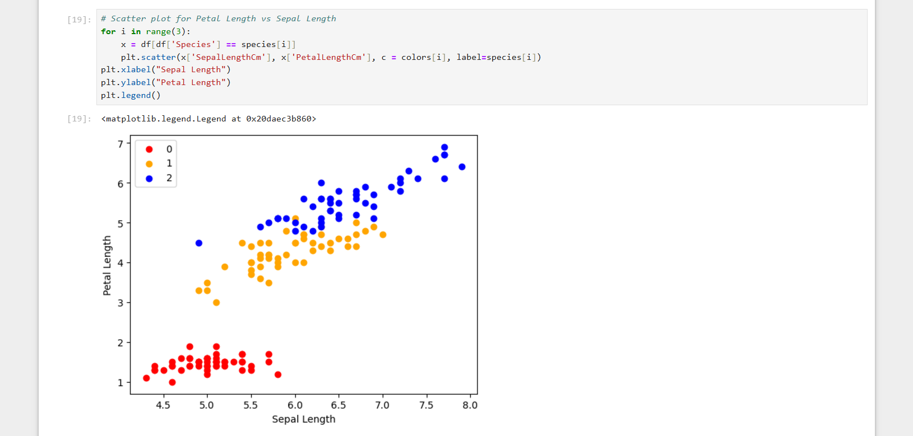

Slide 19
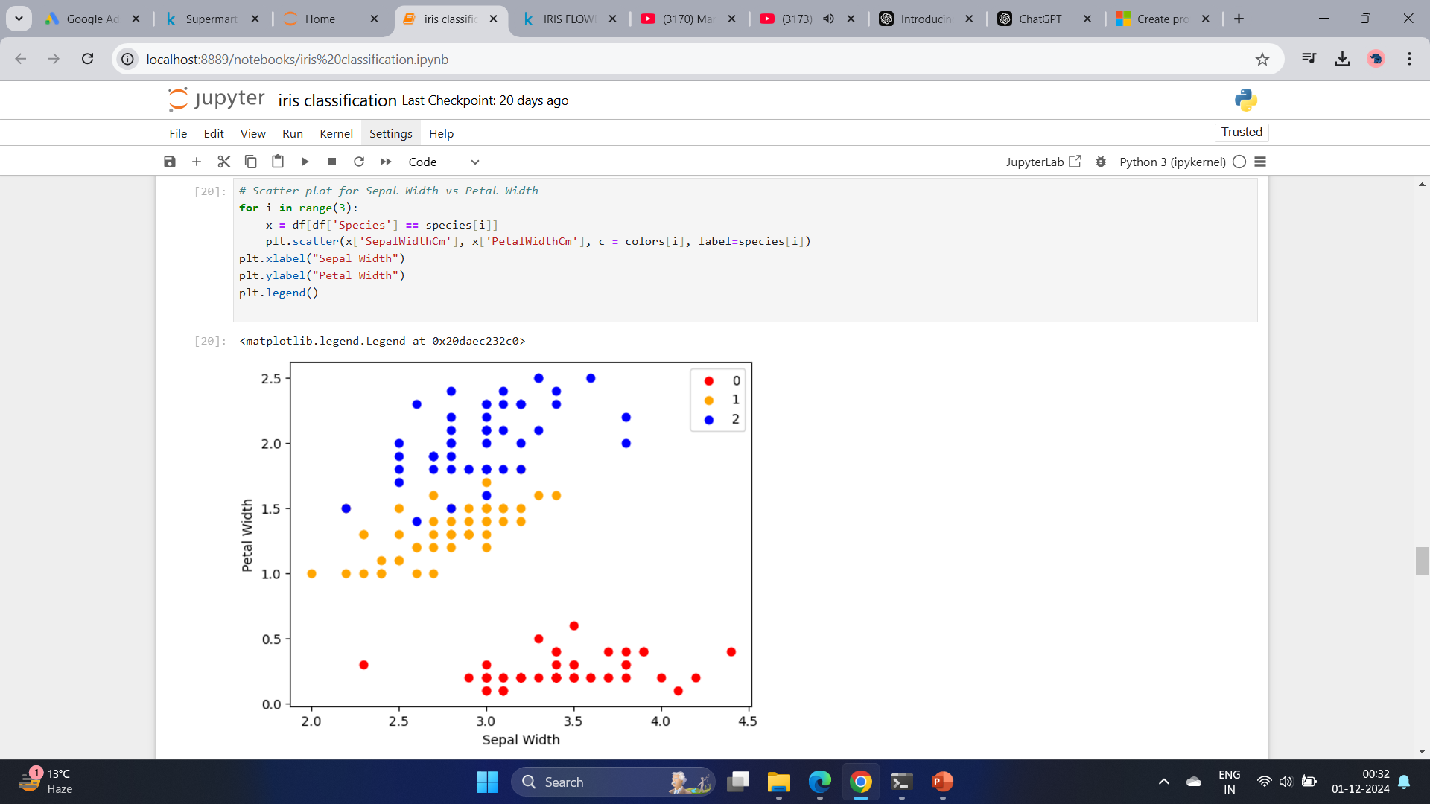

Slide 20
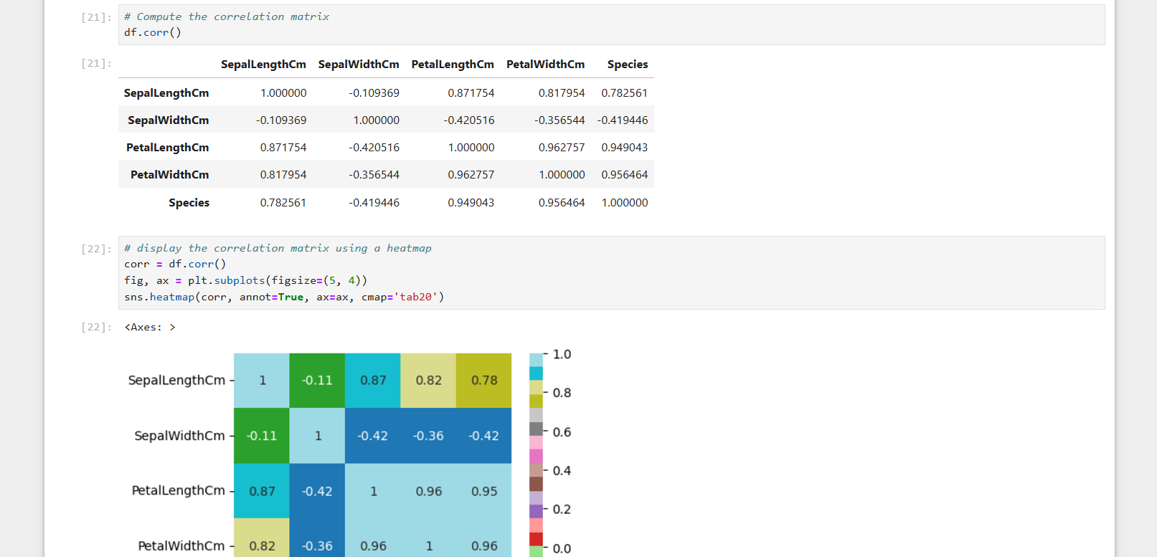

Slide 21
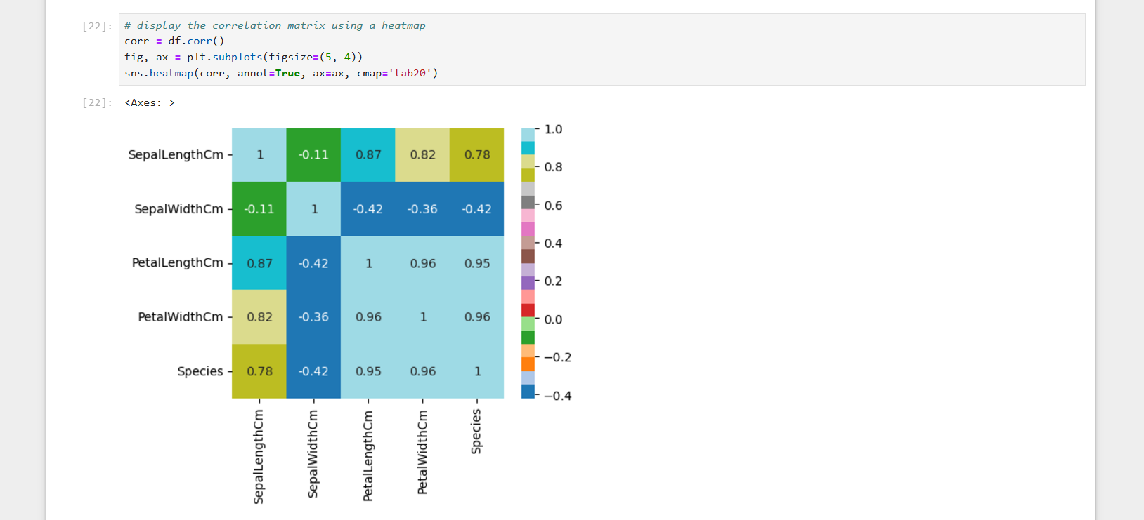

Slide 22
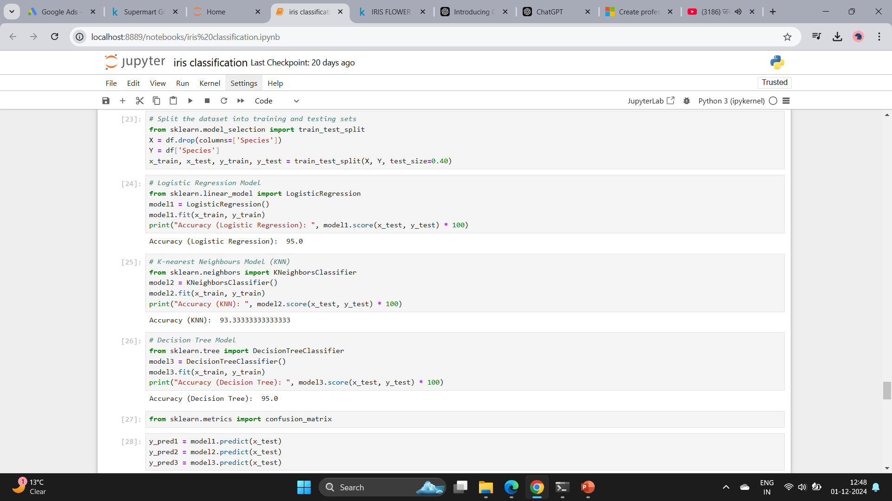

Slide 23
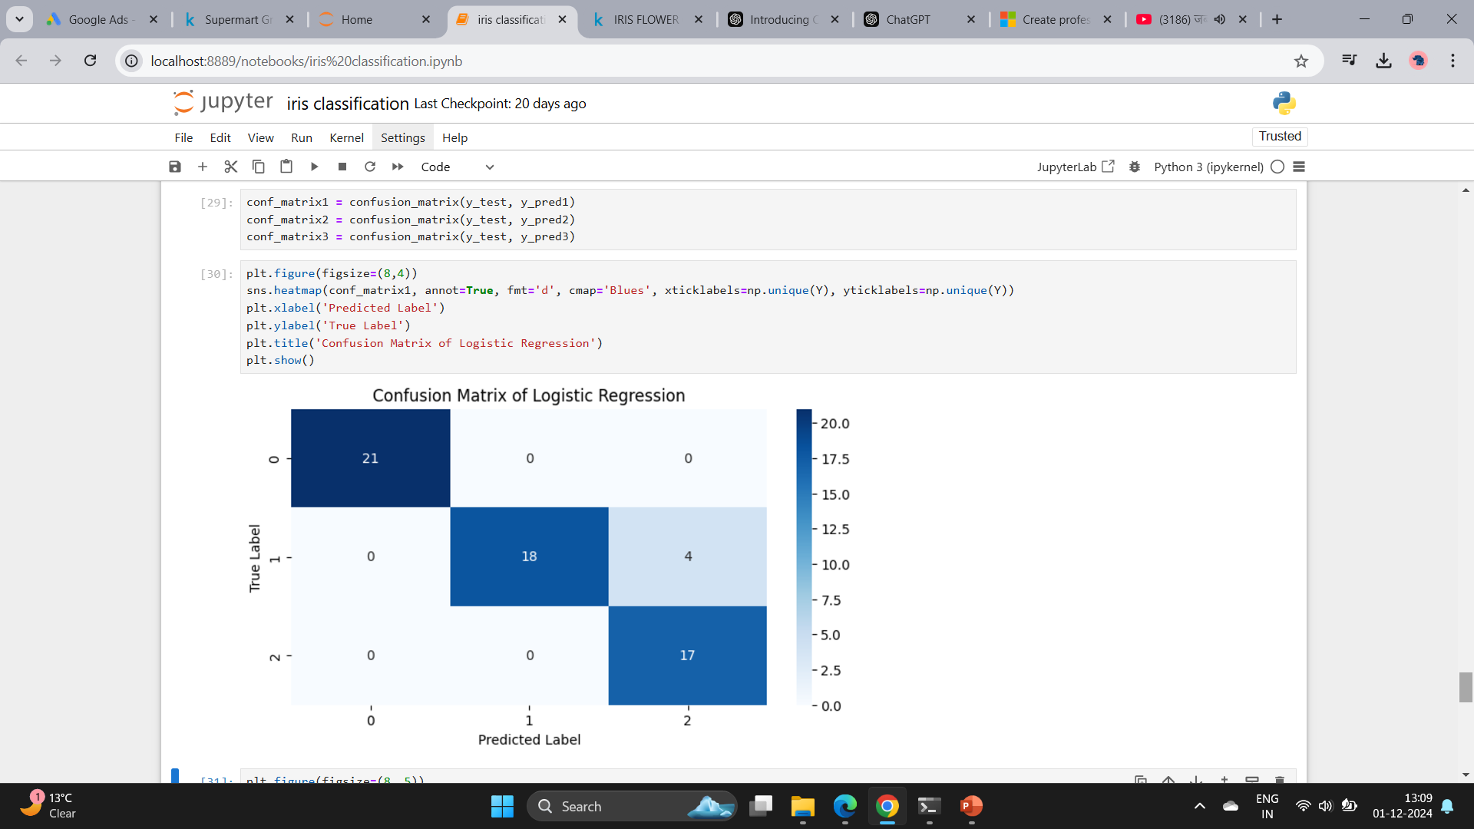

Slide 24
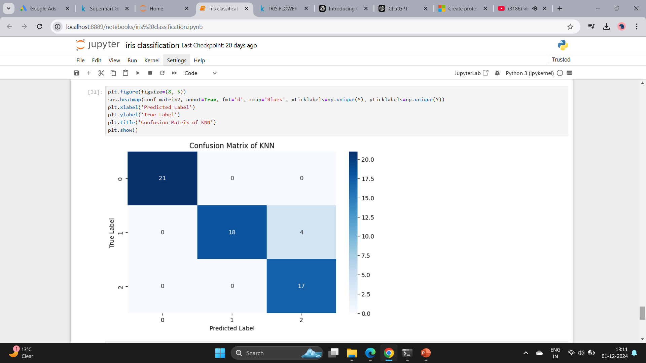

Slide 25
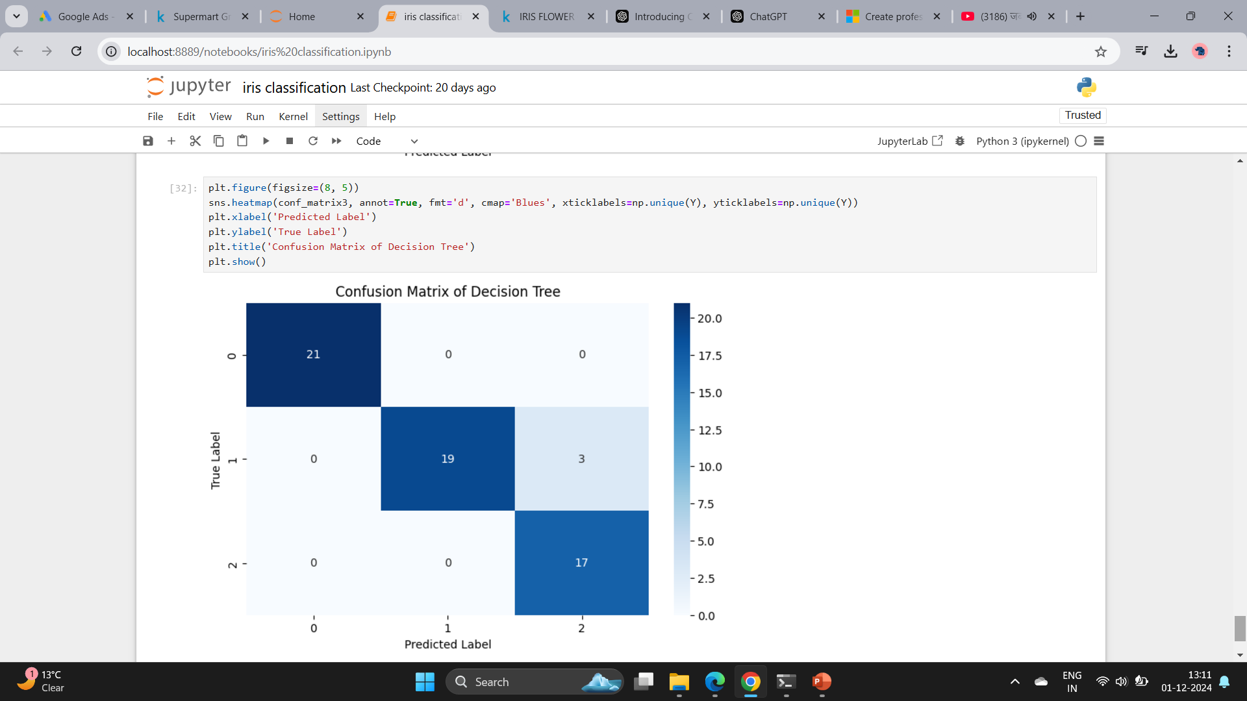

Slide 26
Conclusion
The Iris Classification project accurately classified flowers into Setosa, Versicolour, and Virginica with high reliability.
Metrics like precision and recall confirmed consistent performance, while visualizations and hyperparameter tuning enhanced accuracy.
This project showcased the effective use of machine learning for classification tasks.

Slide 27


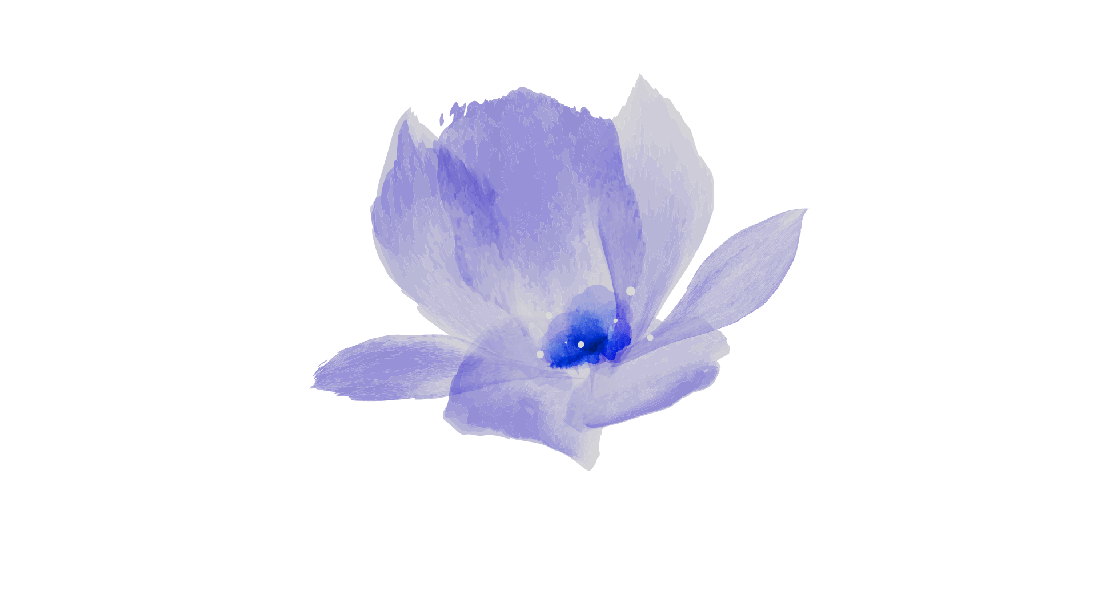
THANK YOU

